Slide 1
Replacement Decisions
APSC 221 – Week 4
Summer 2024

Slide 2
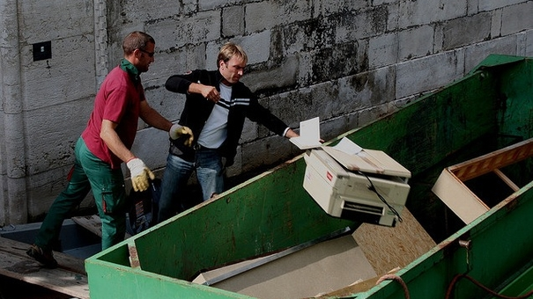

Slide 3

Introduction
Physical assets require evaluation of their value as their age, at regular intervals
At each evaluation, there are 4 available options:
Keep the asset, as is (Do nothing option)
Overhaul the asset, to improve efficiency
Dispose of the asset, without a replacement
Replace the asset with another asset

Slide 4
Reasons for Replacement or Retirement
Replacement
Becomes necessary if there are less expensive means of providing the service, or if the level of service is no longer adequate
Retirement
If there is no longer the need for the service, the asset is removed from service without replacement (retired)

Slide 5
The Basic Question
How long should we keep an asset before replacing it?
Relevant costs for this decision are not always obvious
Assumptions of the replacement assets of the future impact current decision
Definition of economic life is critical in comparison to the asset’s service life
We do this through a replacement decision analysis method known as Equivalent Annual Cost

Slide 6
Asset Costs
What are some of the relevant costs associated with owning an asset?
Capital Costs
Costs associated with the purchase and sale of assets
Largest portion occurs early in the life cycle
Installation Costs
One-time cost at the very start of the asset’s life cycle
Irreversible once the asset is brought on-line
Operating & Maintenance Costs
Costs associated with using the asset to produce goods or services
Generally, an ever-growing cost over time
Some elements may be more constant than others (operation vs maintenance)

Slide 7
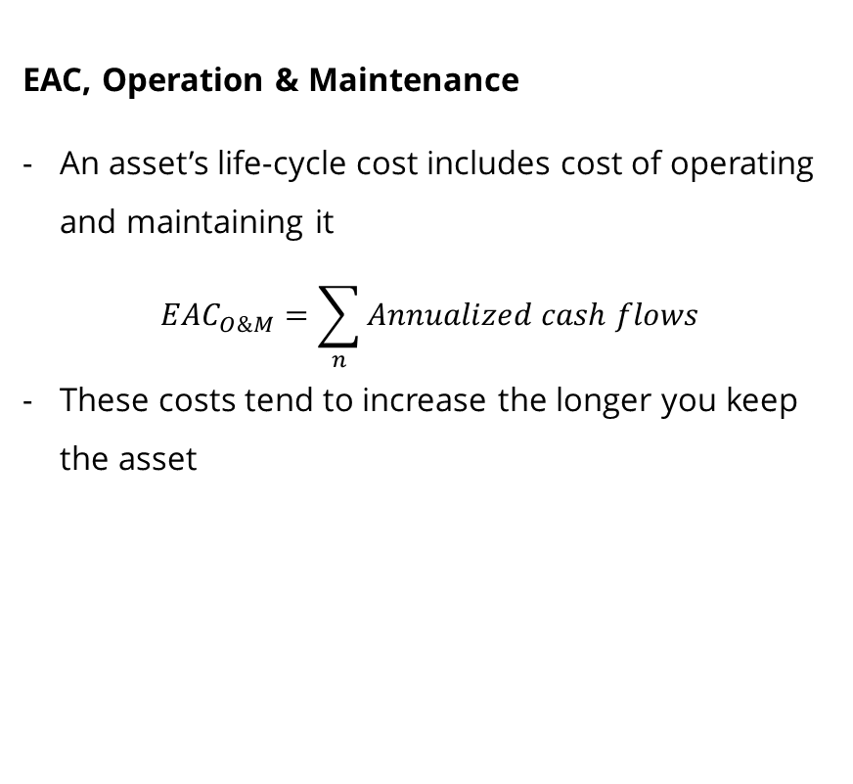
Equivalent Annual Cost
EAC, Capital
Assuming you have an ongoing need for an asset,
EAC_{capital} = (P+I) (A/P, i, N) – S (A/F, i, N)
Note: There are different derivations of this equation
The longer you keep the asset, the lower the annual cost of the capital asset
Note – Salvage value is only a function of the purchase price (not including installation costs)
EAC, Operation & Maintenance
An asset’s life-cycle cost includes cost of operating and maintaining it
$$EAC_{O\&M}=\sum_{n}{Annualized cash flows}$$
These costs tend to increase the longer you keep the asset

Slide 8
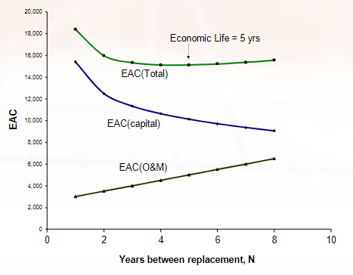

Economic Life
The economic life of an asset is therefore the number of years that minimize the total EAC
$$EAC_{total}=EAC_{capital}+EAC_{O\&M}$$

Slide 9
Replacement Scenarios
Definitions:
Defender – the existing asset
Challenger – the potential replacement
There are 3 potential options in a replacement scenario:
Defender and challenger are identical; the asset need continues indefinitely
The defender and challenger are different; the same challenger continues indefinitely
The defender and challenger are different; the future challengers are also different
We will only discuss Options 1 and 2 in this course.
Notes:
Option 3 requires significant assumptions and intricate calculations. For the purpose of engineering economic analyses, it is simpler and often acceptable to assume Option 2.

Slide 10
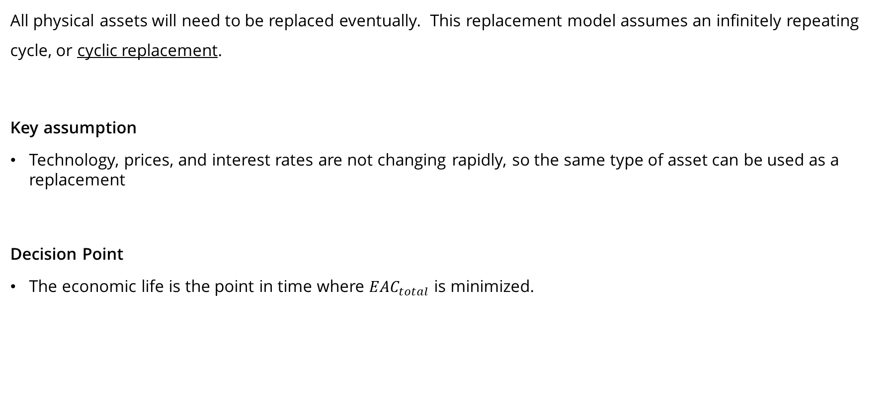
Option 1 – Defender & Challenger are identical
All physical assets will need to be replaced eventually. This replacement model assumes an infinitely repeating cycle, or cyclic replacement.
Key assumption
Technology, prices, and interest rates are not changing rapidly, so the same type of asset can be used as a replacement
Decision Point
The economic life is the point in time where $EAC_{total}$ is minimized.

Slide 11
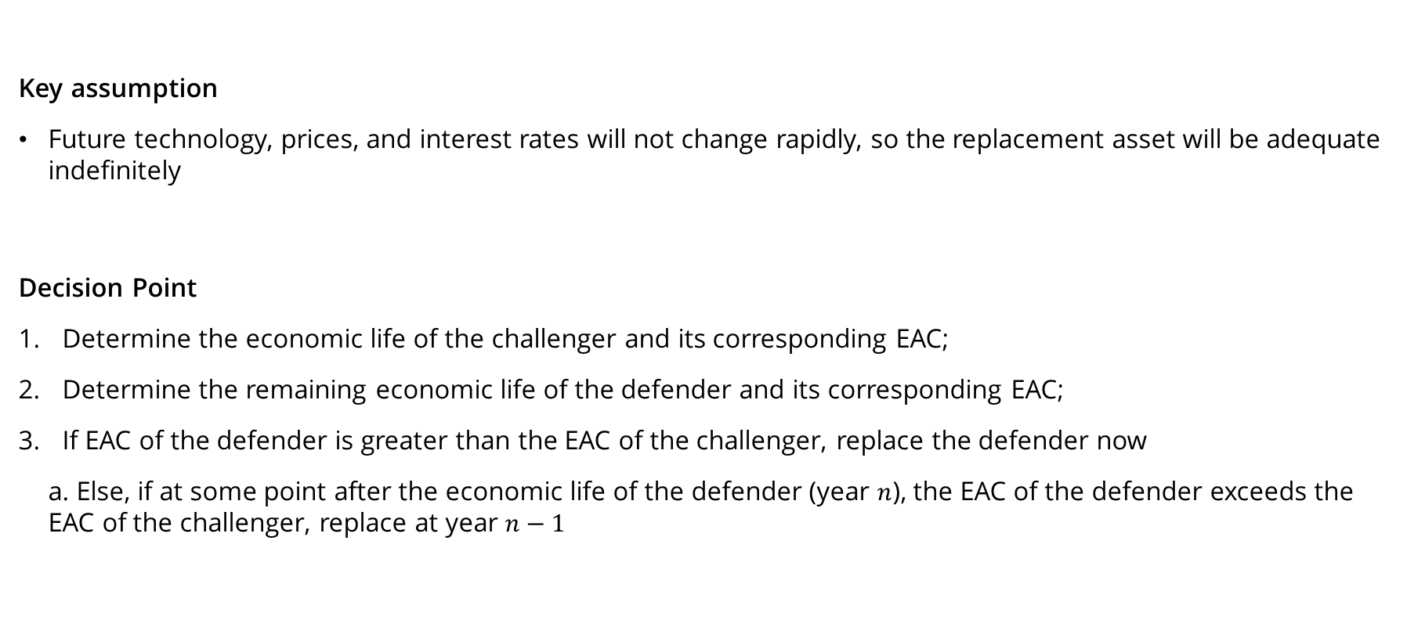
Option 2 – Defender & Challenger are different; Challenger repeats
Key assumption
Future technology, prices, and interest rates will not change rapidly, so the replacement asset will be adequate indefinitely
Decision Point
Determine the economic life of the challenger and its corresponding EAC;
Determine the remaining economic life of the defender and its corresponding EAC;
If EAC of the defender is greater than the EAC of the challenger, replace the defender now
a. Else, if at some point after the economic life of the defender (year $n$), the EAC of the defender exceeds the EAC of the challenger, replace at year $n−1$

Slide 12
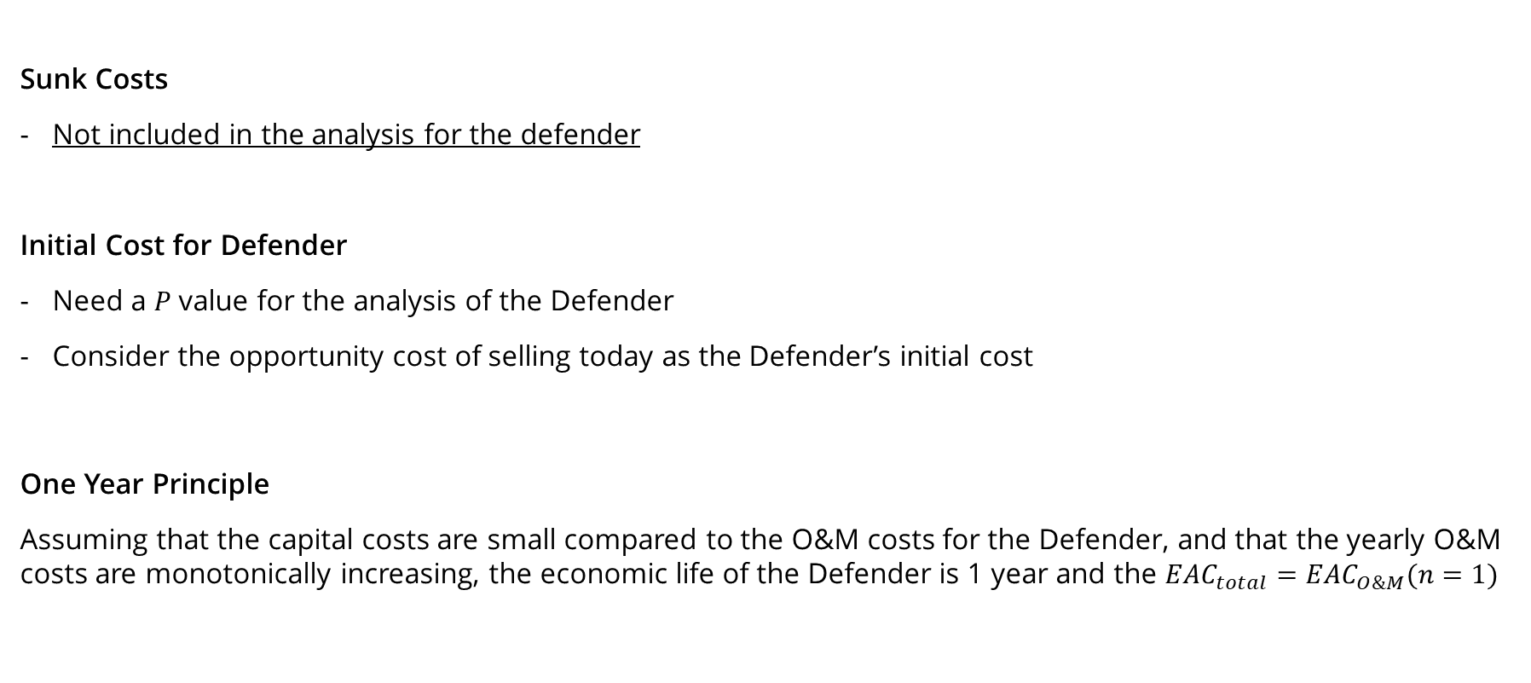
Option 2 – Defender & Challenger are different; Challenger repeats
Sunk Costs
Not included in the analysis for the defender
Initial Cost for Defender
Need a $P$ value for the analysis of the Defender
Consider the opportunity cost of selling today as the Defender’s initial cost
One Year Principle
Assuming that the capital costs are small compared to the O&M costs for the Defender, and that the yearly O&M costs are monotonically increasing, the economic life of the Defender is 1 year and the $EAC_{total}=EAC_{O\&M}(n=1)$
Notes:
One year principle useful when looking at a Defender that has been in place for many years and is known to be near the end of its economic and service life.

Slide 13
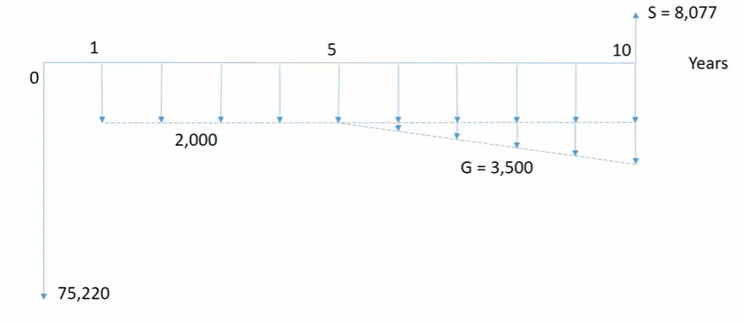
Example
An asset is purchased for $72,000 and costs $3,220 to install. At the end of its 10-year service life, the salvage value is estimated to be $8,077. The annual O&M costs are expected to be $2,000 for the first 5 years, increasing by $3,500 per year starting in Year 6. Assuming a MARR of 12%, what is the economic life of this asset?

Slide 14
Example
Notes:
d = 1-(72000/8077)^(1/10)
S(n) = 72000(1-d)^n
S(1) = 57,600
EAC(1) = (P+I-S)(A/P, 12%, 1) + S(0.12) + 2000 = 28,646
S(2) = 46,080
EAC(2) = (P+I-S)(A/P, 12%, 2) + S(0.12) + 2000 = 24,772
S(3) = 36,864
EAC(3) = (P+I-S)(A/P, 12%, 3) + S(0.12) + 2000 = 22,391
S(4) = 29,491
EAC(4) = (P+I-S)(A/P, 12%, 4) + S(0.12) + 2000 = 20,593
S(5) = 23,593
EAC(5) = (P+I-S)(A/P, 12%, 5) + S(0.12) + 2000 = 19,153
S(6) = 18,874
EAC(6) = (P+I-S)(A/P, 12%, 6) + S(0.12) + 2000 + 3500 (A/F, 12%, 6) = 18,399
S(7) = 15,099
EAC(7) = (P+I-S)(A/P, 12%, 7) + S(0.12) + 2000 + 3500 (P/G, 12%, 3)(P/F, 12%, 4)(A/P, 12%, 7) = 18,067
S(8) = 12,080
EAC(8) = (P+I-S)(A/P, 12%, 8) + S(0.12) + 2000 + 3500 (P/G, 12%, 4)(P/F, 12%, 4)(A/P, 12%, 8) = 18,008
S(9) = 9,664
EAC(9) = (P+I-S)(A/P, 12%, 9) + S(0.12) + 2000 + 3500 (P/G, 12%, 5)(P/F, 12%, 4)(A/P, 12%, 9) = 18,135

